Slide 1


Infosys springboard Vritual Internship
Project Name: FoodTrends: Understanding Customer Preferences in F&B
Group ID: Group 1, Batch-11
Team Members: Lekhana S.R
Mentor:Ms. Nityasree

Slide 2
Title and Objective
Objective:
•Decode Customer Personas: To transform demographic data (Age, Income, Occupation) into "Customer Profile Intelligence" that identifies who the high-value diners are.
•Analyze Ordering Ecosystems: To map "Ordering Patterns & Platform Behavior," determining whether customers prefer direct interaction or digital delivery apps.
•Evaluate Service Excellence: To measure "Delivery Experience & Quality" by correlating wait times and food freshness with overall customer satisfaction ratings.
•Identify Market Drivers: To uncover "Cuisine Performance & Influence Factors" (like discounts and health concerns) to help restaurants optimize their menus and promotions.

Slide 3
Execution & Milestone Reviews
Dataset Source: The dataset (order final.xlsx) contains 388 records of customer orders with 35 features including Age, Gender, Monthly Income, Rating, and Food Preferences.
Milestone Breakdown:
Milestone 1 :- Data Understanding & Preparation
Data cleaning, handling missing and inconsistent values, standardizing categorical fields, and understanding the dataset structure. This stage focused on identifying key attributes related to customers, orders, services, and external factors to ensure accurate analysis.
Milestone 2 :- Core Dashboard Development
Development of the Customer Profile Intelligence, Order & Food Preference Analysis, and Ordering Patterns & Platform Behaviour dashboards. These dashboards focus on customer demographics, food preferences, ordering platforms, and time-based ordering behavior.

Slide 4
Milestone 3 :- Service & Decision Analysis
Deep analysis of Delivery Experience & Service Quality and Customer Decision & Influence Factors. This phase evaluates service satisfaction, affordability, payment preferences, ratings influence, and decision-making drivers.
Milestone 4 :- Strategic & Performance Insights
Analysis of Restaurant & Cuisine Performance Insights and Promotion, Time & External Impact Analysis, focusing on cuisine trends, regional performance, promotional impact, and external factors such as temperature and time.

Slide 5
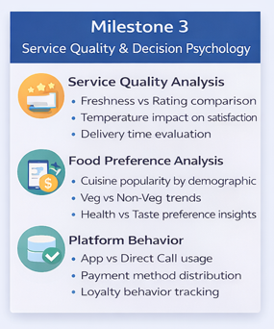
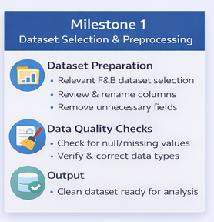
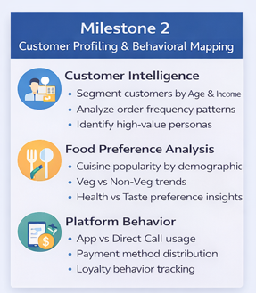
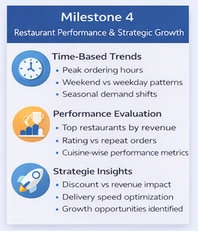
Project execution and milestones

Slide 6
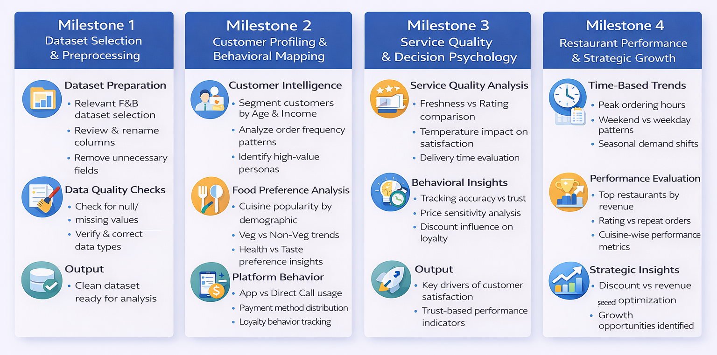

Slide 7
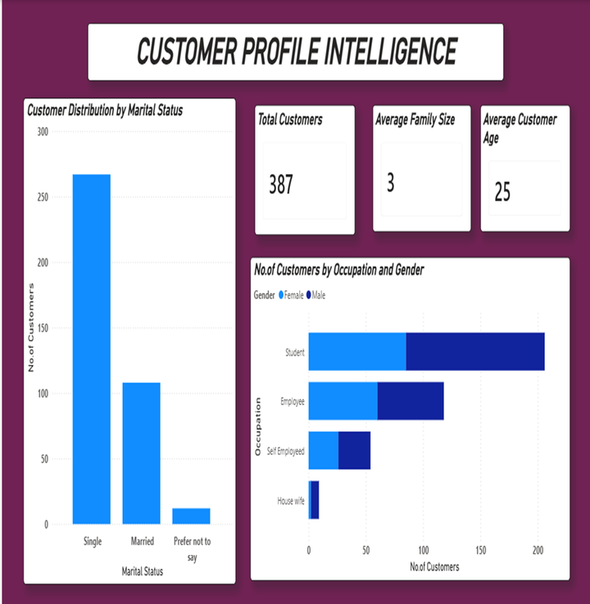
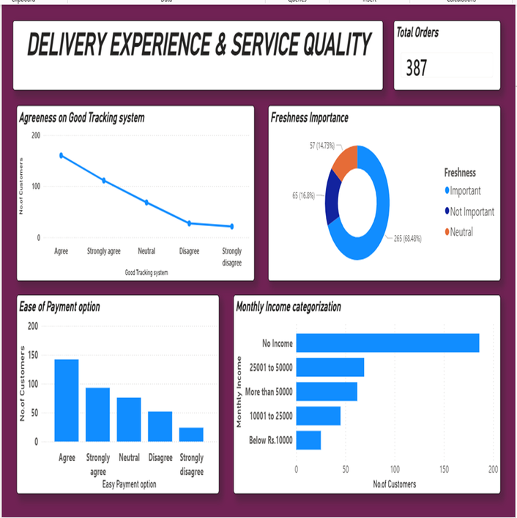
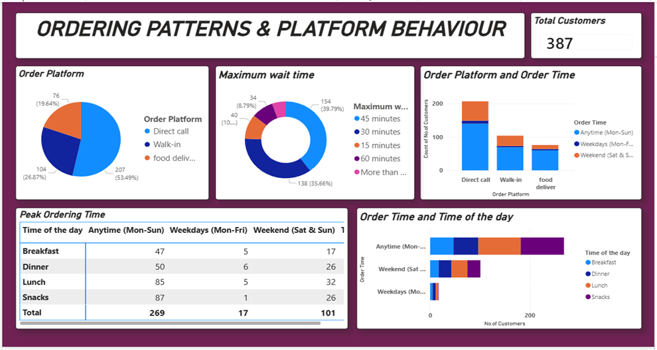
Dashboard
images

Slide 8
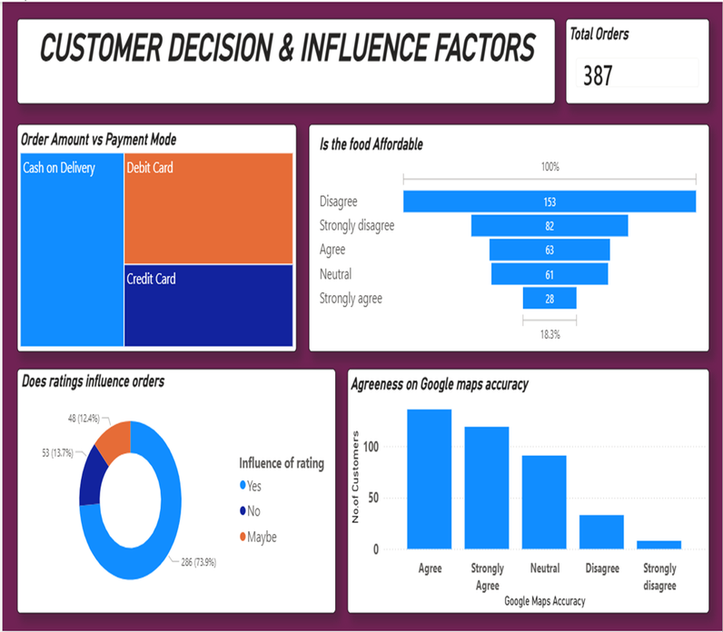
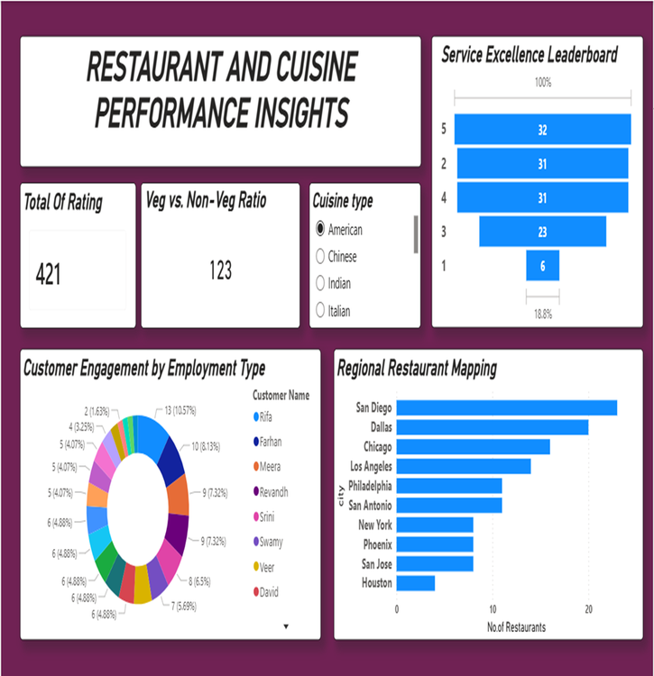
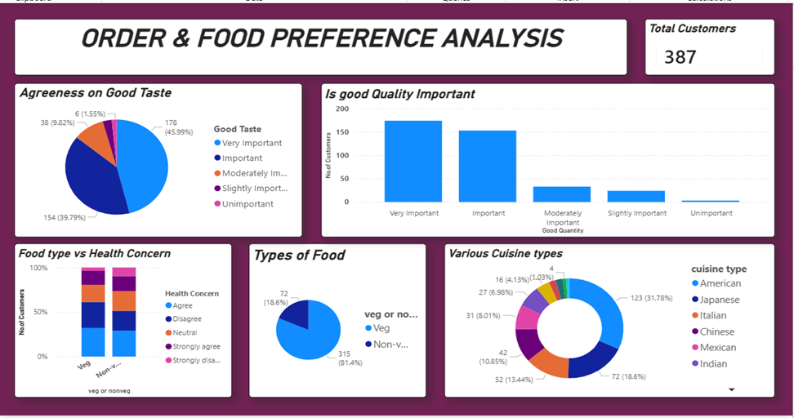
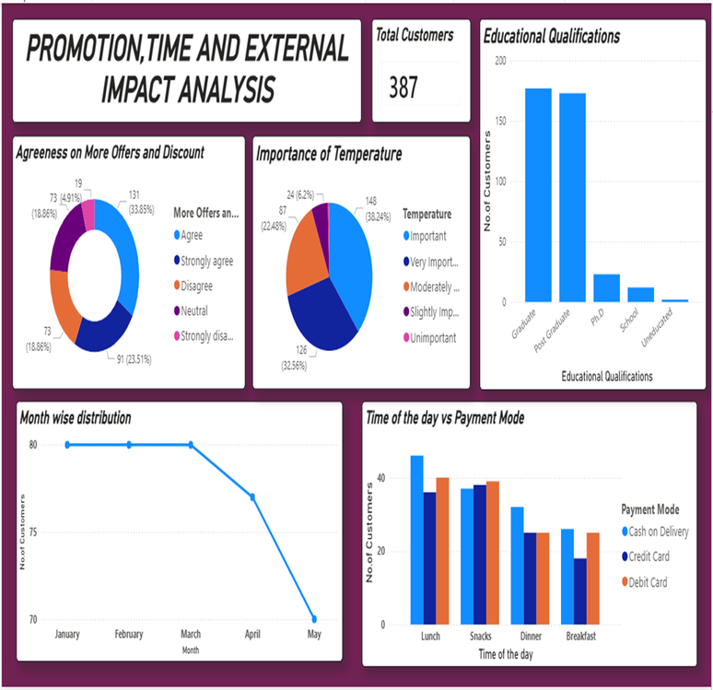

Slide 9
CHALLENGES FACED AND RESOLUTION
•Challenge 1: Data Categorization: Many columns like "Monthly Income" and "Maximum wait time" were categorical strings.
•Resolution: Used data mapping and encoding to convert them into usable formats for analysis.
•Challenge 2: Multi-variate Analysis: Difficulty in seeing how 'Health Concern' and 'Affordability' act together.
•Resolution: Created heatmaps and pivot tables to visualize overlapping preferences.
•Challenge 3: Outliers in Order Amounts: Some order values were significantly higher than average.
•Resolution: Used box plots to identify and validate these entries against the "Family Size" column.

Slide 10
Learnings and Skills Used
Power BI: Used for end-to-end Business Intelligence—from data ingestion to publishing interactive 7-page reports.
Power Query: Performed ETL (Extract, Transform, Load) to clean the Dataset.
Data Science & Visualization Skills:
Data Modeling: Established relationships between different data categories to ensure seamless filtering across all 7 dashboard pages.
DAX (Data Analysis Expressions): Created custom measures for "Average Rating," "Total Orders," and "Customer Sentiment Scores."
Advanced Visualizations: Implemented Slicers (for City/Gender), Decomposition Trees (to find influence factors), and Ribbon Charts (for trend analysis over time).
Interactive Reporting: Configured Cross-filtering and Sync Slicers so that a selection on the "Customer Profile" page reflects on the "Cuisine Performance" page.

Slide 11
Key Insights and Future Enhancement
Key Insights:
Student Influence: A large portion of the dataset consists of students with "No Income," yet they frequently order "Veg" and "Snacks."
Trust Factor: Google Maps accuracy and "Good Tracking Systems" are rated as "Important" by over 70% of respondents.
Health Trend: There is a strong correlation between "Strongly Agree" on Health Concern and "Veg" food preferences.
Future Enhancement:
Machine Learning Integration: Building a recommendation engine based on past ratings.
Real-time Analysis: Integrating API data from live food delivery apps to study peak-hour trends.

Slide 12

CONCLUSION
Our comprehensive analysis reveals that the F&B industry has shifted from a Product-centric model to a Trust-centric model. Through our 7-page Power BI dashboard, we proved that while 'Taste' gets the first order, 'Transparency'—in the form of tracking accuracy and delivery speed—earns the second.
By identifying the high-volume student demographic and the surprising strength of direct-call ordering, we have provided a roadmap for brands to optimize their digital presence. Ultimately, success in today's market requires a balance of health-conscious options and seamless operational execution."

Slide 13
Acknowledgement and References
We would like to express our heartfelt gratitude to the Infosys Springboard Team for organizing this valuable internship opportunity and providing a strong learning platform.
We sincerely thank our Mentor for her continuous support, guidance, and constructive feedback throughout the project.
We are also grateful to our teammates for their collaboration, encouragement, and valuable insights during the project work.
This internship has been a significant step in our professional growth and technical journey, helping us strengthen our skills in data analysis and visualization.
References
•Microsoft Power BI Documentation
•Infosys Springboard Virtual Internship course materials

Slide 14
THANK YOU

